Slide 1
21CSS201T COMPUTER ORGANIZATION AND ARCHITECTURE UNIT-2 Topic : Functional Units of a Computer

Slide 2


Slide 3
FUNCTIONAL UNITS OF COMPUTER
Input Unit
Output Unit
Central processing Unit (ALU and Control Units)
Memory
Bus Structure

Slide 4
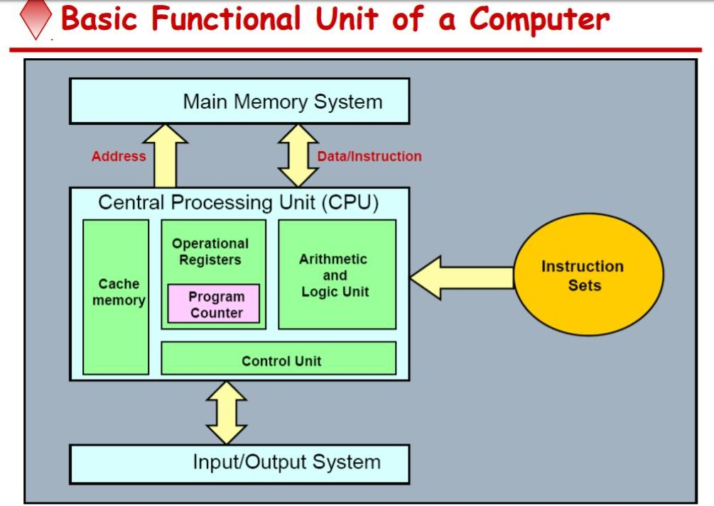

Slide 5
What is a computer?
a computer is a sophisticated electronic calculating machine that:
Accepts input information,
Processes the information according to a list of internally stored instructions and
Produces the resulting output information.
Functions performed by a computer are:
Accepting information to be processed as input.
Storing a list of instructions to process the information.
Processing the information according to the list of instructions.
Providing the results of the processing as output.
What are the functional units of a computer?
6

Slide 6
Functions
ALL computer functions are:
Data PROCESSING
Data STORAGE
Data MOVEMENT
CONTROL
Data = Information
Coordinates How Information is Used

Slide 7
Functions of a computer
The operations performed by a computer using the functional units can be summarized as follows:
It accepts information (program and data) through input unit and transfers it to the memory.
Information stored in the memory is fetched, under program control, into an arithmetic and logic unit for processing.
Processed information leaves the computer through an output unit.
The control unit controls all activities taking place inside a computer.

Slide 8
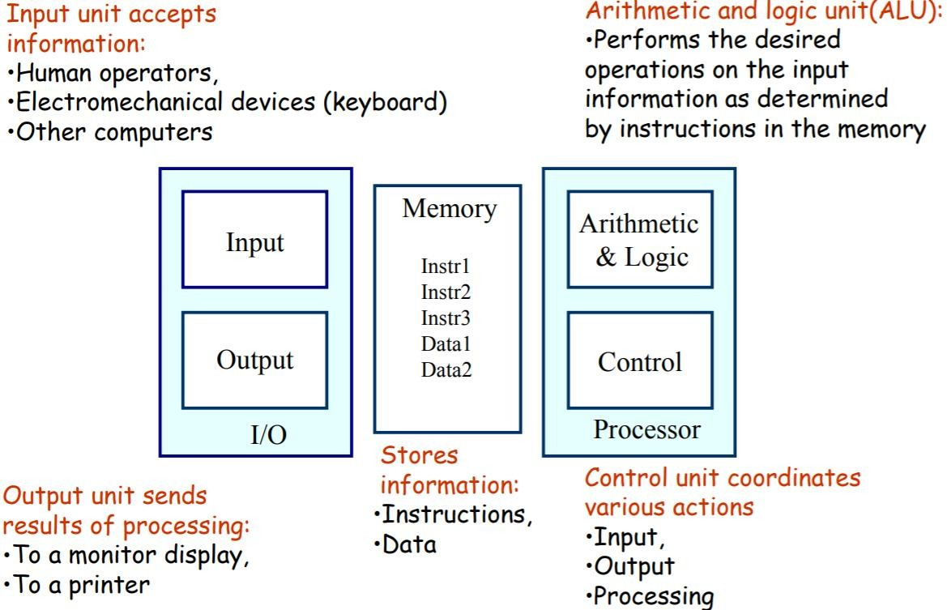

Slide 9
Arithmetic and logic unit (ALU)
Operations are executed in the Arithmetic and Logic Unit (ALU).
Arithmetic operations such as addition, subtraction.
Logic operations such as comparison of numbers.
In order to execute an instruction, operands need to be brought into the ALU from the memory.
Operands are stored in general purpose registers available in the ALU.
Access times of general purpose registers are faster than the cache.
Results of the operations are stored back in the memory or retained in the processor for immediate use.
9

Slide 10
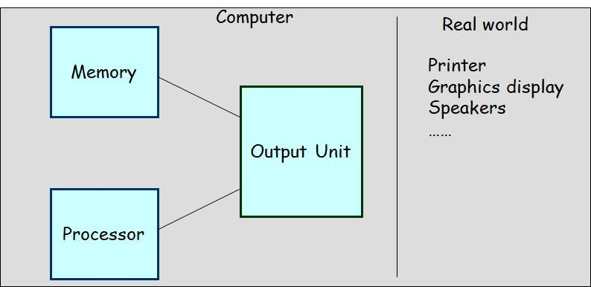
Output unit
Computers represent information in a specific binary form.
Output units:
Interface with output devices.
Accept processed results provided by the computer in specific binary form.
Convert the information in binary form to a form understood by an output device.
10

Slide 11
Control unit
Operation of a computer can be summarized as:
Accepts information from the input units (Input unit).
Stores the information (Memory).
Processes the information (ALU).
Provides processed results through the output units (Output unit).
Operations of Input unit, Memory, ALU and Output unit are coordinated by Control unit.
Instructions control “what” operations take place (e.g. data transfer, processing).
Control unit generates timing signals which determines “when” a particular operation takes place.
11

Slide 12
CPU (Central processing Unit)
The “brain” of the machine
Responsible for carrying out computational task
Contains ALU, CU, Registers
ALU Performs Arithmetic and logical operations
CU Provides control signals in accordance with some timings which in turn controls the execution process
Register Stores data and result and speeds up the operation

Slide 13
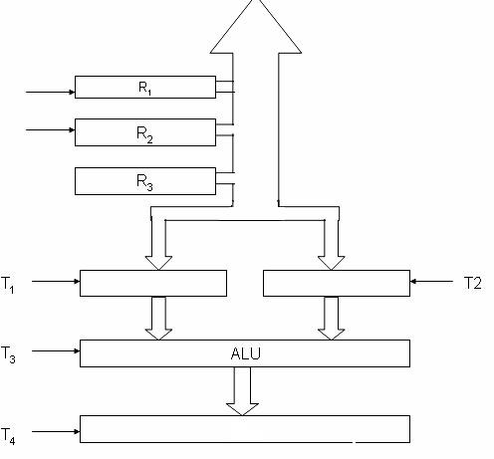
CONTROL UNIT
Control unit works with a reference signal called Processor clock
T1
T2
Processor divides the operations into basic steps
E a c h b a s i c s t e p i s executed in one clock cycle
R1
R2
R2

Slide 14
Example
Add R1, R2
T1
Enable R1
T2
Enable R2
T3
Enable ALU for addition operation
T4
Enable out put of ALU to store result of the operation

